Slide 1
Chap 3 SYNCHRONIZATION

Slide 2
Clock Synchronization
In a centralized system, time is unambiguous.
If process A asks for the time, and then a little later process B asks for the time, the value that B gets will be higher than (or possibly equal to) the value A got. It will certainly not be lower.
If the source file input. c has time 2151 and the corresponding object file input.o has time 2150, program knows that input.c has been changed since input.o was created, and thus input.c must be recompiled.
On the other hand, if output.c has time 2144 and output.o has time 2145, no compilation is needed. Thus program goes through all the source files to find out which ones need to be recompiled and calls the compiler to recompile them.

Slide 3
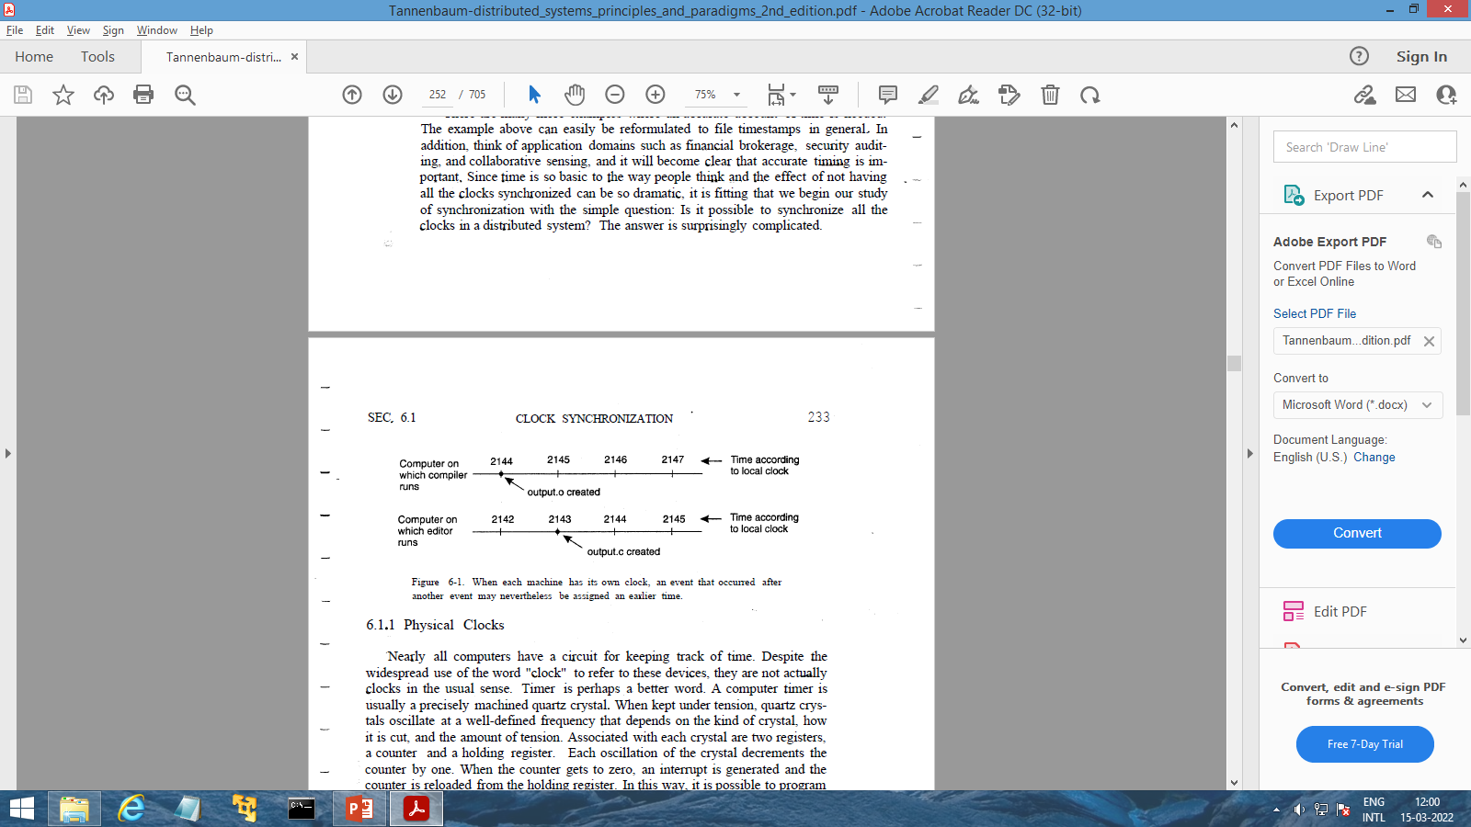
What would happen in a distributed system in which there were no global agreement on time????
Suppose that output.o has time 2144 as before, and shortly thereafter output.c is modified but is assigned time 2143 because the clock on its machine is slightly behind, as shown below

Slide 4
The program will not call the compiler. The resulting executable binary program will then contain a mixture of object files from the old sources and the new sources.
It will probably crash and the programmer will go crazy trying to understand what is wrong with the code.

Slide 5
LOGICAL CLOCKS
So far we have assumed that clock synchronization is naturally related to real time.
However, it is also possible that it may be sufficient that every node agrees on a current time, without that time necessarily being the same as the real time.
For eg: It is adequate that two nodes agree that input.o is outdated by a new version of input.c.
In this case, keeping track of each other's events is what matters.

Slide 6
If two processes do not interact, it is not necessary that their clocks be synchronized because the lack of synchronization would not be observable and thus could not cause problems.
Furthermore, what usually matters is not that all processes agree on exactly what time it is, but rather that they agree on the order in which events occur.
In the previous example, what counts is whether input.c is older or newer than input.o, not their absolute creation times.

Slide 7
1. Lamport's Logical Clocks
To synchronize logical clocks, Lamport defined a relation called happens-before.
The expression a → b is read "a happens before b" and means that all processes agree that first event a occurs, then afterward, event b occurs.
The happens-before relation can be observed directly in two situations:
1. If a and b are events in the same process, and a occurs before b, then a → b is true.
2. If a is the event of a message being sent by one process, and b is the event of the message being received by another process, then a → b is also true. A message cannot be received before it is sent, or even at the same time it is sent, since it takes a finite, nonzero amount of time to arrive.

Slide 8
Happens-before is a transitive relation, so if a → b and b → c, then a → c.
If two events, x and y, happen in different processes that do not exchange messages (not even indirectly via third parties), then x → y is not true, but neither is y → x.
These events are said to be concurrent, which simply means that nothing can be said about when the events happened or which event happened first.

Slide 9
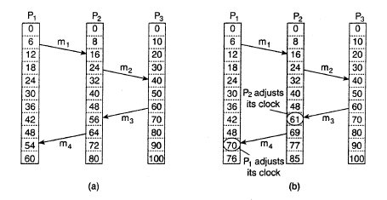
For every event ‘a’, we can assign it a time value C(a)
So, if a → b, then C(a) < C(b).

Slide 10
Lamport's solution follows directly from the happens-before relation. Since m3 left at 60, it must arrive at 61 or later.
Therefore, each message carries the sending time according to the sender's clock.
When a message arrives and the receiver's clock shows a value prior to the time the message was sent, the receiver fast forwards its clock to be one more than the sending time.

Slide 11
IMPLEMENTATION OF LAMPORT'S LOGICAL CLOCKS
Each process Pi maintains a local counter Ci. These counters are updated as follows :
1. Before executing an event (i.e., sending a message over the network, delivering a message to an application, or some other internal event), Pi executes Ci ← Ci+1
2. When process Pi sends a message m to Pj, it sets m’s timestamp ts (m) equal to Ci after having executed the previous step.
3. Upon the receipt of a message m, process Pj adjusts its own local counter as Cj ← max{Cj, ts(m)}, after which it then executes the first step (i.e Cj←Cj+1) and delivers the message to the application.

Slide 12
2. Vector clock
Lamport's logical clocks lead to a situation where all events in a distributed system are totally ordered with the property that if event a happened before event b, then a will also be positioned in that ordering before b, that is, C (a) < C (b).
However, nothing can be said about the relationship between two events a and b by merely comparing their time values C(a) and C(b), respectively.
In other words, if C(a) < C(b), then this does not necessarily imply that a indeed happened before b.

Slide 13
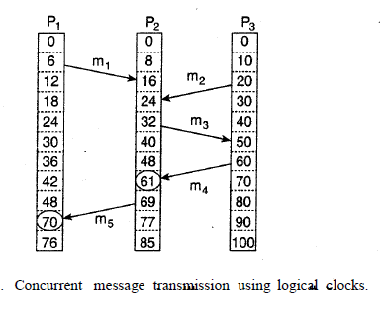
Tsnd (mi) : logical time at which message mi, was sent
Trcv (mi) : logical time at which message mi, was received
Thus we know that for each msg (mi) , Tsnd (mi) < Trcv (mi)
However, Trcv (mi) < Tsnd (mj) ????

Slide 14
The problem is that Lamport clocks do not capture causality.
Causality can be captured by means of vector clocks.
A vector clock VC (a) assigned to an event a has the property that if VC (a) < VC (b) for some event b, then event a is known to causally precede event b.
Vector clocks are constructed by letting each process P, maintain a vector VCi with the following two properties:
VCi [i] is the number of events that have occurred so far at Pi. In other words, VCi [i] is the local logical clock at process Pi.
VCi [j] = k, then Pi knows that k events have occurred at Pj. It is thus Pi ‘s knowledge of the local time at Pj.

Slide 15
The first property is maintained by incrementing VCi [i] at the occurrence of each new event that happens at process Pi.
The second property is maintained by piggybacking vectors along with messages that are sent.
In particular, the following steps are performed:
Before executing an event, Pi executes VCi [i]← VCi [i]+1.
When process Pi sends a message m to Pj, it sets m's vector timestamp ts(m) equal to VCi after having executed the previous step.
Upon the receipt of a message m, process Pj adjusts its own vector by setting VCj [k] ← max {VCj [k], ts (m)[k] } for each k, after which it executes the first step and delivers the message to the application

Slide 16
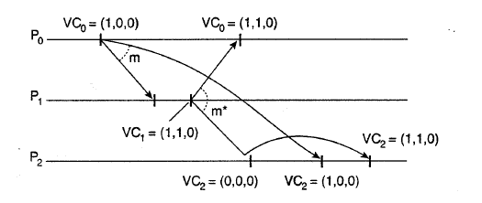
Using vector clocks, it is now possible to ensure that a message is delivered only if all messages that causally precede it have also been received as well.

Slide 17
ELECTION algorithm
Many distributed algorithms require any one process to act as coordinator, initiator, or otherwise perform some special role. In general, it does not matter which process takes on this special responsibility, but one of them has to do it.
If all processes are exactly the same, with no distinguishing characteristics, there is no way to select one of them to be special. Consequently, we will assume that each process has a unique process number.
In general, election algorithms attempt to locate the process with the highest process number and designate it as coordinator.
The algorithms differ in the way they do the location

Slide 18
Furthermore, we also assume that every process knows the process number of every other process.
What the processes do not know is which ones are currently up and which ones are currently down.
The goal of an election algorithm is to ensure that when an election starts, it concludes with all processes agreeing on who the new coordinator is to be.

Slide 19
Traditional election algorithms
BULLY ALGORITHM:
When any process notices that the coordinator is no longer responding to requests, it initiates an election.
A process P, holds an election as follows:
P sends an ELECTION message to all processes with higher numbers.
If no one responds, P wins the election and becomes coordinator.
If one of the higher-ups answers, it takes over the election process & P's job is done.

Slide 20
At any moment, a process can get an ELECTION message from one of its lower-numbered colleagues.
When such a message arrives, the receiver sends an OK message back to the sender to indicate that he is alive and will take over.
The receiver then holds an election. Eventually, all processes give up but one, and that one is the new coordinator.
It announces its victory by sending all processes a message telling them that starting immediately it is the new coordinator.
If a process that was previously down comes back up, it holds an election.
If it happens to be the highest-numbered process currently running, it will win the election and take over the coordinator's job.

Slide 21
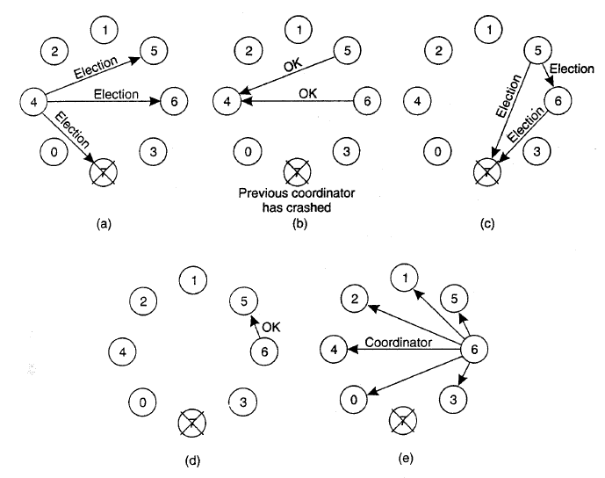

Slide 22
2. Ring algorithm:
Unlike some ring algorithms, this one does not use a token.
We assume that the processes are physically or logically ordered, so that each process knows who its successor is.
When any process notices that the coordinator is not functioning, it builds an ELECTION message containing its own process number and sends the message to' its successor.
If the successor is down, the sender skips over the successor and goes to the next member along the ring, or the one after that, until a running process is located.
At each step along the way, the sender adds its own process number to the list in the message effectively making itself a candidate to be elected as coordinator.

Slide 23
Eventually, the message gets back to the process that started it all. That process recognizes this event when it receives an incoming message containing its own process number.
At this point, the message type is changed to COORDINATOR and circulated once again, this time to inform everyone else who the coordinator is (the list member with the highest number) and who the members of the new ring are.
When this message has circulated once, it is removed and everyone goes back to work.

Slide 24
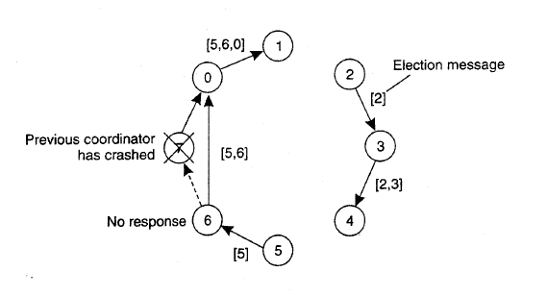
Ring based election algorithm

Slide 25
Mutual exclusion
Concurrency and collaboration among multiple processes is the fundamental of distributed systems.
i.e Processes will need to simultaneously access the same resources.
This concurrent accesses may corrupt the resource, or make it inconsistent.
Thus, Mutual exclusion is needed to address the concurrency and collaboration problem.

Slide 26
Distributed mutual exclusion algorithms can be classified into two different categories.
Token based Mutual Exclusion Algorithm
Achieved by passing a special message (known as a token) between the processes.
Permission based Mutual Exclusion Algorithm
A process wanting to access the resource first requires the permission of other processes.

Slide 27
Token Based Mutual Exclusion
In token-based solutions, mutual exclusion is achieved by passing a special message between the processes, known as a token.
There is only one token available and who ever has that token is allowed to access the shared resource.
When finished, the token is passed on to a next process.
If a process having the token is not interested in accessing the resource, it simply passes it on.

Slide 28
Advantages:
Token-based solutions avoid starvation.
Deadlocks can be easily avoided
Drawbacks:
If the token is lost (process holding the token crashes), an intricate distributed procedure needs to be started to create a new token.

Slide 29
Centralized algorithm
Simulation of one-processor system based mutual exclusion.
One process is elected as the coordinator.
Whenever a process wants to access a shared resource, it sends a request message to the coordinator stating which resource it wants to access and asking for permission.
If no other process is currently accessing that resource, the coordinator sends back a reply granting permission.
Method used to deny permission is system dependent.

Slide 30
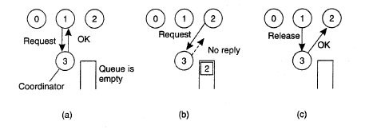
If any other process (Eg: P2) asks for permission to access the same resource, the coordinator cannot grant permission.
The request is put in Queue.
When process 1 is finished with the resource, it sends a message to the coordinator releasing its exclusive access.
The coordinator can now grant the access of this resource to the 1st process waiting in the queue.

Slide 31
Advantages:
Algorithm guarantees mutual exclusion.
Requests are granted in the order in which they are received.
No process ever waits forever (no starvation).
Easy to implement.
Requires only three messages per use of resource (request, grant, release).
Drawbacks:
Coordinator is a single point of failure.
Cannot distinguish a dead coordinator from "permission denied“
In a large system, a single coordinator can become a performance bottleneck.

Slide 32
De-Centralized algorithm
Each resource is assumed to be replicated ‘n’ times.
Every replica has its own coordinator for controlling the access by concurrent processes.
Whenever a process wants to access the resource, it will simply need to get a majority vote from m > n/2 coordinators.
Unlike in the centralized scheme, when a coordinator does not give permission to access a resource, it will tell the requester.
If permission to access the resource is denied (i.e., a process gets less than m votes), it is assumed that it will back off for a randomly-chosen time, and make a next attempt later.

Slide 33
This method makes the original centralized solution less vulnerable to failures of a single coordinator.
When a coordinator crashes, it recovers quickly but will have forgotten any vote it gave before it crashed.
May incorrectly grant this permission again to another process after its recovery.
If too many nodes want to access the same resource, the utilization will drop rapidly.

Slide 34
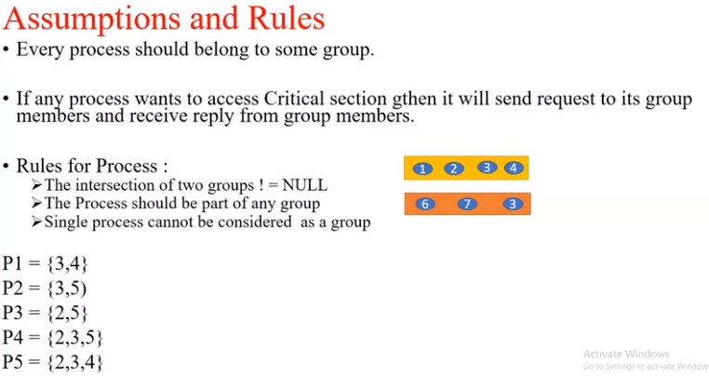
Maekawa‘s Algorithm

Slide 35
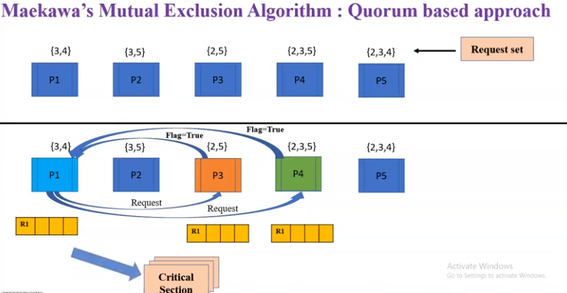

Slide 36
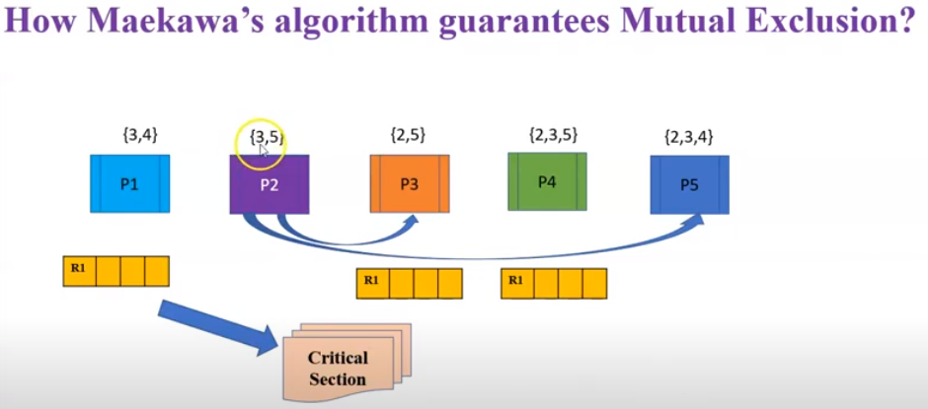
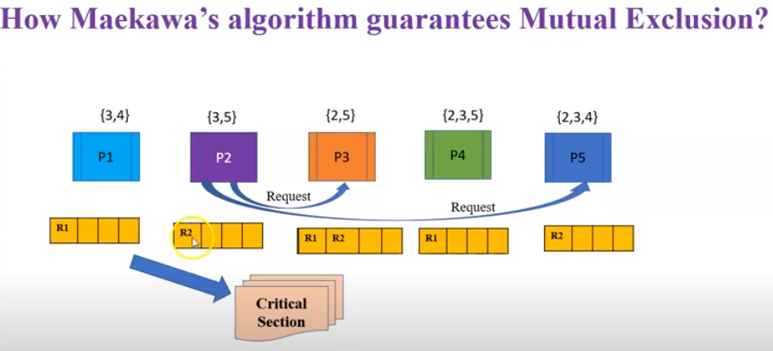

Slide 37
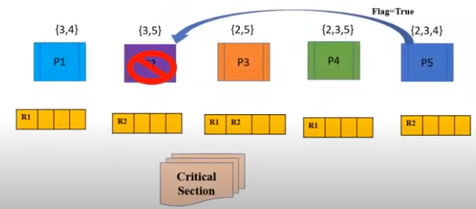
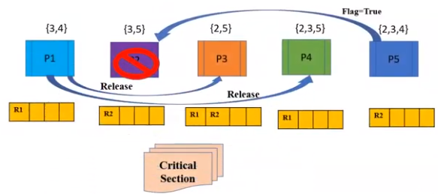

Slide 38
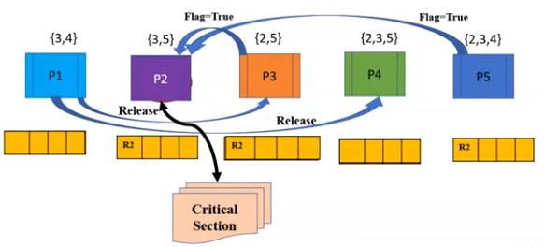

Slide 39
Token ring algorithm
We have a bus network (e.g. Ethernet), with no inherent ordering of the processes.
A logical ring is constructed in which each process is assigned a position in the ring.
The ring positions may be allocated in numerical order of network addresses or some other means.
Ordering of the process does not matter.
What matters is that each process knows who is next in line after itself.

Slide 40
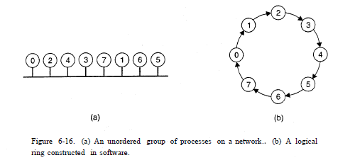
When the ring is initialized, process 0 is given a token.
The token circulates around the ring.
Token is passed from process k to process k +1 in point-to-point messages.

Slide 41
When a process acquires the token from its neighbor, it checks to see if it needs to access the shared resource.
If so, the process goes ahead, does all the work it needs to, and then releases the resources.
Once finished, the process passes the token along the ring.
It is not permitted to immediately enter the resource again using the same token.
If a process is not interested in the resource, it just passes the token along.
When no processes need the resource, the token just circulates at high speed around the ring.

Slide 42
Advantages:
Only one process has the token at any instant, so only one process can actually get to the resource at a time.
No starvation due to revolving token.
At worst, a process will have to wait for every other process to use the resource.
Drawbacks:
If the token is ever lost, the token must be regenerated.
Difficult to detect when the token is lost.

Slide 43
Distributed algorithm (Ricart and Agrawala's algorithm)
Ricart and Agrawala's algorithm requires total ordering of all events in the system.
That is, for any pair of events, such as messages, it must be unambiguous which one actually happened first.
Lamport's algorithm is one way to achieve this ordering and can be used to provide timestamps for distributed mutual exclusion.

Slide 44
STEPS IN DISTRIBUTED ALGORITHM:
When a process wants to access a shared resource, it builds a message containing the name of the resource, its process number, and the current (logical) time.
It then sends the message to all other processes, conceptually including itself. The sending of messages is assumed to be reliable; that is, no message is lost.
When a process receives a request message from another process, the action it takes depends on its own state with respect to the resource named in the message.

Slide 45
The 3 possible actions that a receiver may take are as follows:
Not accessing the resource and does not want to access it:
Sends back an OK message to the sender.
B. Already has access to the resource:
Simply does not reply. Instead, it queues the request.
C. Wants to access the resource as well but has not yet done so:
Compares the timestamp of the incoming message with the one contained in the message that it has sent everyone. If the incoming message has a lower timestamp, the receiver sends back an OK message. If its own message has a lower timestamp, the receiver queues the incoming request and sends nothing.

Slide 46
After sending out requests asking permission, a process sits back and waits until everyone else has given permission. As soon as all the permissions are in, it may go ahead.
When it is finished, it sends OK messages to all processes on its queue and deletes them all from the queue.

Slide 47
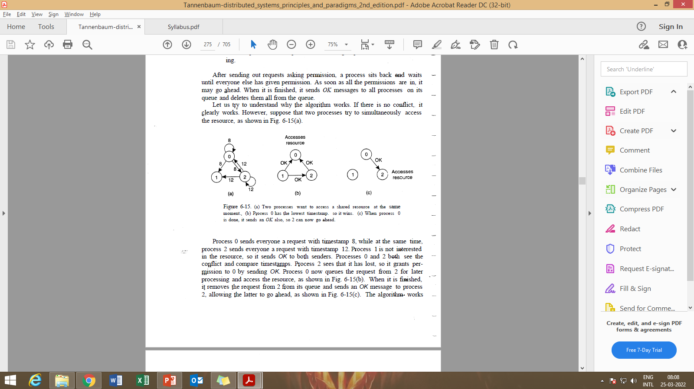

Slide 48
Features of Distributed Algorithm:
Mutual exclusion is guaranteed without deadlock or starvation.
No single point of failure but instead possibly n points of failure.
Crashed process will fail to respond to incoming requests, that would be incorrectly interpreted as denial of permission.
This would thus block all subsequent attempts by all other processes to enter all critical regions.
Probability of one of the n processes failing is at least n times as large as a single coordinator failing.

Slide 49
Either a multicast communication primitive must be used, or each process must maintain the group membership list.
Works best with small groups of processes that never change their group memberships
All processes are involved in all decisions concerning accessing the shared resource. Thus it might lead to multiple Bottlenecks.
The algorithm is slower, more complicated, more expensive, and less robust than the original centralized one

Slide 50
Possible solution:
When a request comes in, the receiver always sends a reply, either granting or denying permission.
If a request or a reply is lost, the sender times out and keeps trying until either a reply comes back or the sender concludes that the destination is dead.
If a request is denied, the sender should block waiting for a subsequent OK message.
Can be modified to grant permission when it has collected permission from a simple majority of the other processes, rather than from all of them.

Slide 51
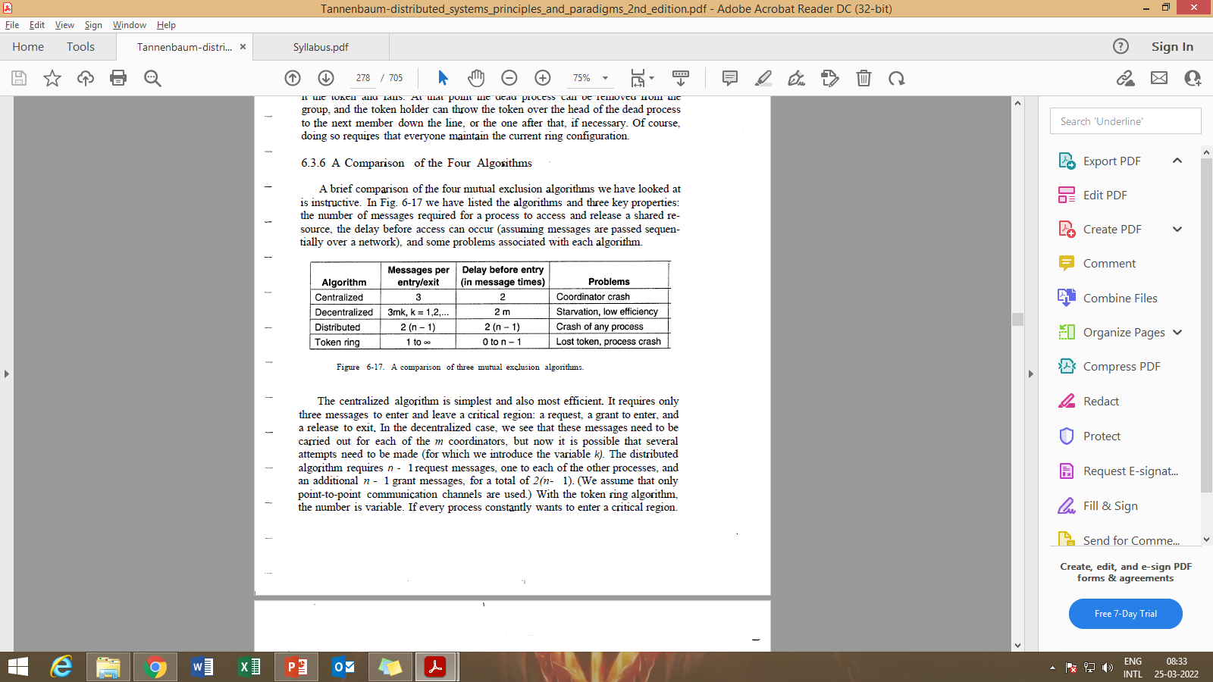
Comparison of the Four Algorithms

Slide 52
Token Based Algorithms
Suzuki- Kasami’s Broadcast Algorithms
Singhal‘s Heurastic Algorithm
Raymond‘s Tree based Algorithm

Slide 53
Suzuki- Kasami’s Broadcast Algorithms
It is a modification of Ricart- Agrawala algorithm (permission based Non-token based algorithm using REQUEST and REPLY messages to ensure mutual exclusion).
In token-based algorithms, A site is allowed to enter its critical section if it possesses the unique token.
Non-token based algorithms uses timestamp to order requests for the critical section where as sequence number is used in token based algorithms.
Each requests for critical section contains a sequence number. This sequence number is used to distinguish old and current requests.

Slide 54
Each process maintains
an array req[ ], where req[i] denotes the sequence no of the latest request from the process i.
Holder of the token maintains
An array last [ ], where last [i] denotes the sequence number of the latest visit to the CS from process i.
A queue Q, to maintain all waiting processes.

Slide 55
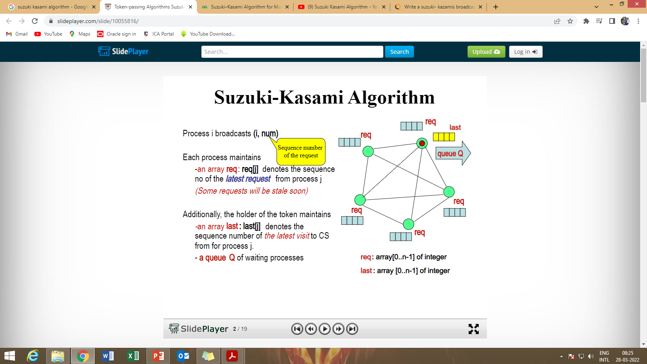

Slide 56
Algorithm
If a site currently without the token wants to enter the critical section (CS), it broadcasts a REQUEST for token message to all other sites.
Token holder sends the token to the requester if it itself is not in the CS. Otherwise, it sends the token after exiting the CS.
A token holder can make multiple CS access at a time.

Slide 57
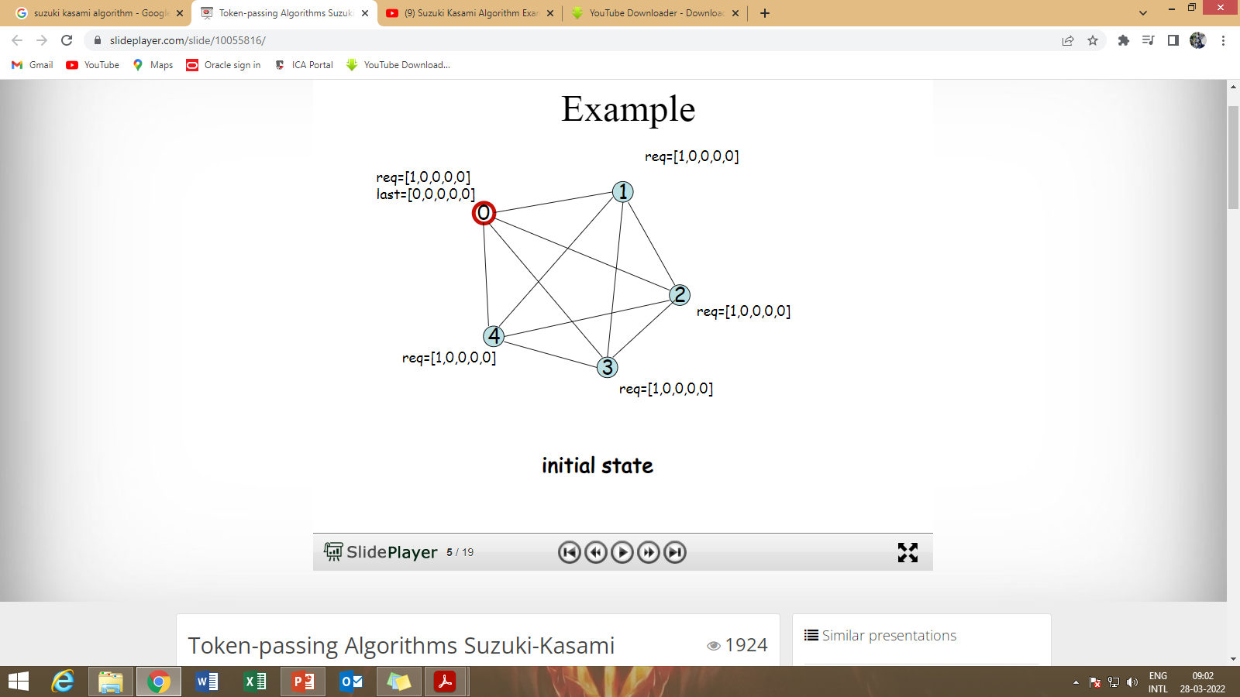
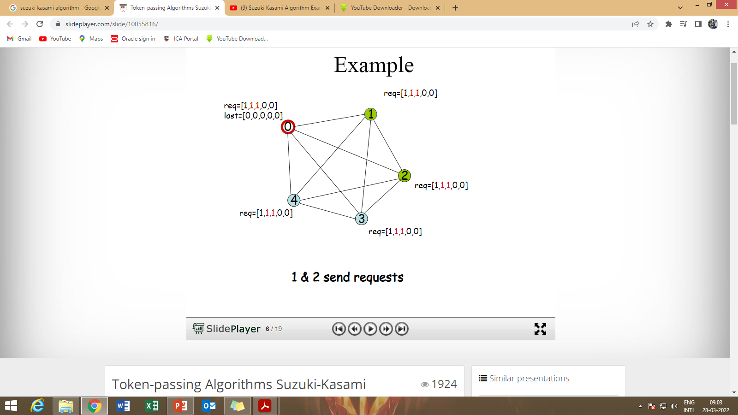

Slide 58
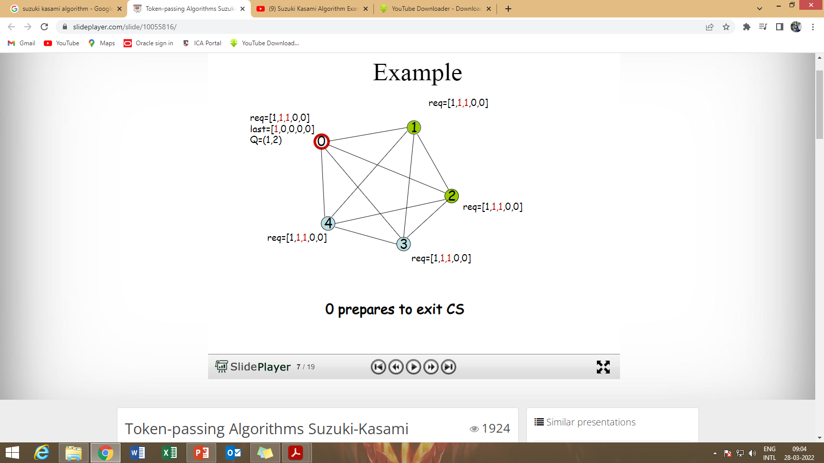
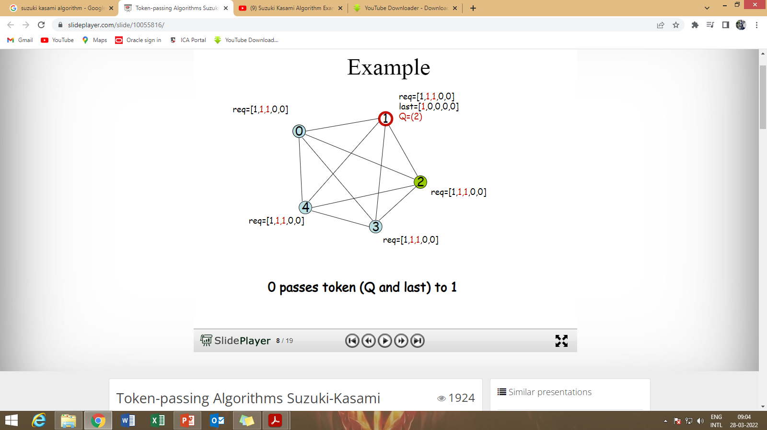

Slide 59

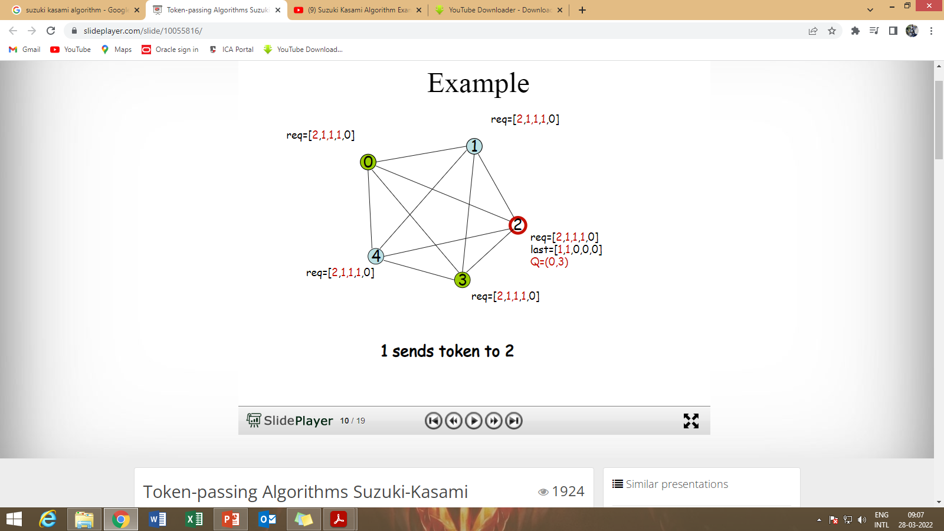

Slide 60
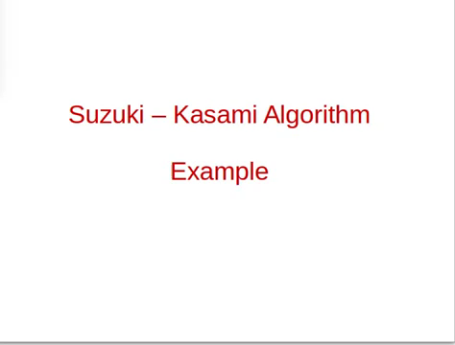

Slide 61
Singhal‘s Heurastic Algorithm
Instead of broadcast, each site maintains info of other sites in order to guess the site that is likely to have the token and sends request only to that site.
Every site maintains:
SV[1.....n] to record states and SN[1…….n] to hold sequence number
Token contains 2 arrays:
TSV[1….n] and TSN[1……n]
States of a site:
R – Requesting CS
E – Executing CS
H – Holding the token, Idle
N – None of the above

Slide 62
Algorithm
Requesting the CS:
Set SVi [i] =R
Set SNi [i]= SNi [i]+1
Si sends req (i, sn) to Sj (Unicast msg)
If SNj [i] > sn, Sj will discard the request (Outdated request)
If SNj [i] < sn, Sj will update SNj [i] = sn and the state is updated as follows:

Slide 63
If SVj [j]=N, SVj [i]=R
If SVj [j]=E, SVj [i]=R
If SVj [j]=H, SVj [i]=R
If SVj [j]=R, and if SVj [i]≠R,
set SVj [i]=R and Sj sends req (j, sn) to Si
Token →R, Seq no →sn

Slide 64
2. Executing the CS:
Si executes the CS, and sets SVi[i] = E
3. Releasing the CS:
After Si finishes executing the CS, Si → SVi[i] = N, TSV[i]=N
For all Sj, if SNi[j] > TSN[j], then
TSV[j]= SVi[j] and TSN[j]= SNi[j]
Else SVi[j] = TSV[j] and SNi[j]=TSN[j]
If SVi[j] = N, set SVi[i] = H

Slide 65
Raymond‘s Tree based Algorithm
Raymond’s tree based algorithm is lock based algorithm.
All sites are arranged as a directed tree such that the edges of the tree are assigned direction towards the site that holds the token.
Site which holds the token is also called root of the tree.
Every site S_{i} has a local variable, called holder that points to an immediate neighbour node on a directed path to the root node.
Every site S_{i} keeps a FIFO queue, called request_q

Slide 66
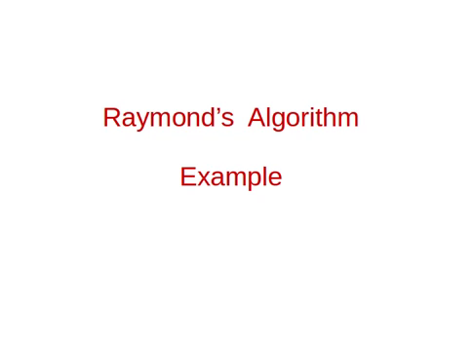

Slide 67
THE END

